Slide 1

Donatella Versace

Slide 2
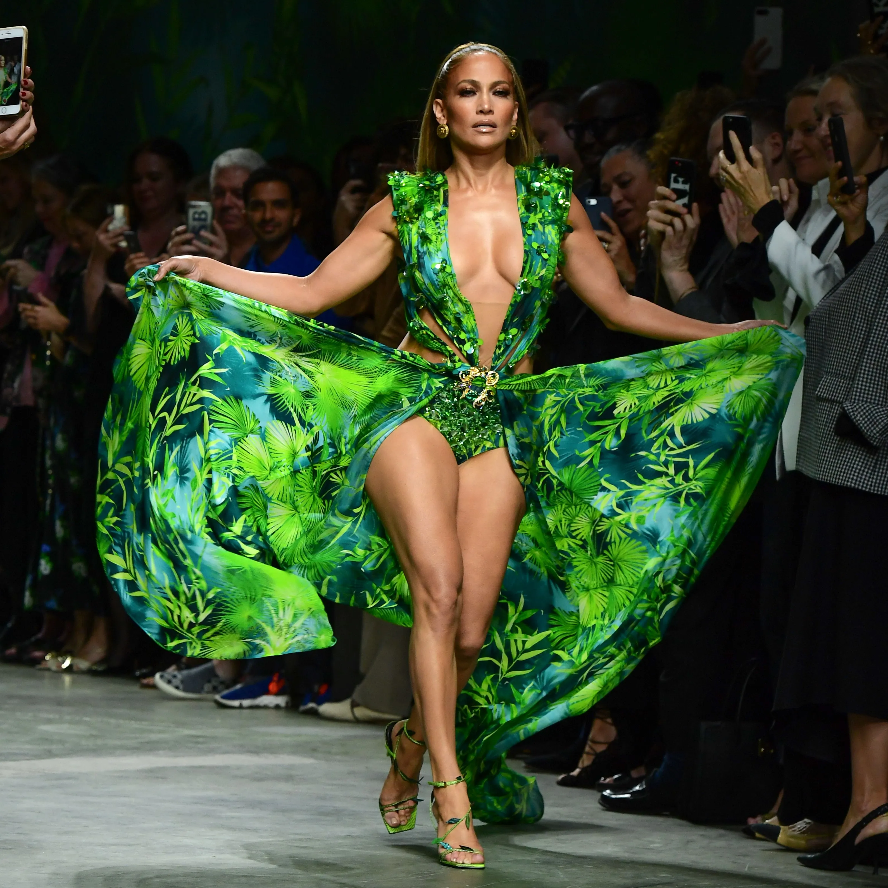

Slide 6
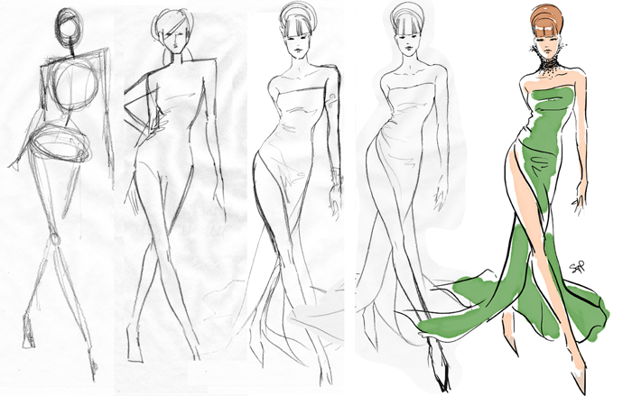
Model

Slide 7
Model
Model + Data
Estimate
Estimator

Slide 8
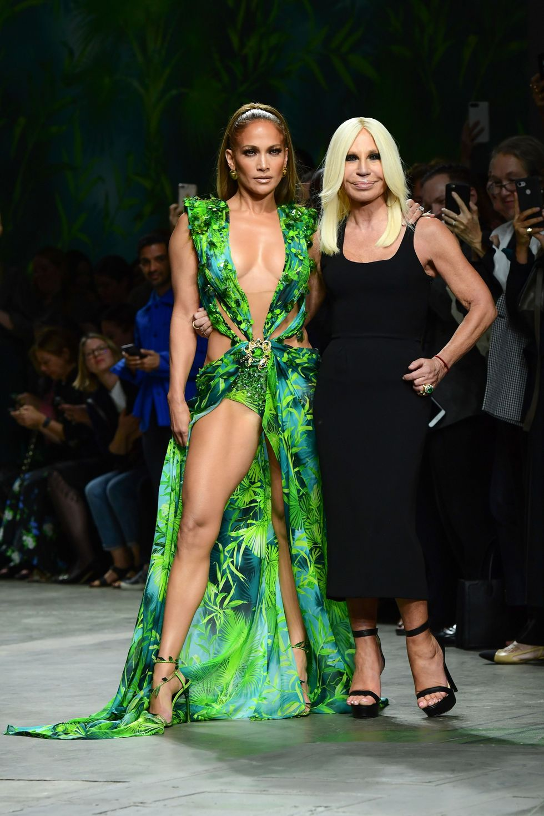

Slide 9


Slide 10


Slide 11
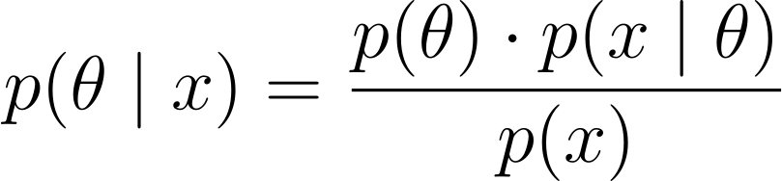

Slide 12
PRIOR
LIKELIHOOD
POSTERIOR
KNOWN NORMALIZING CONSTANT

Slide 13
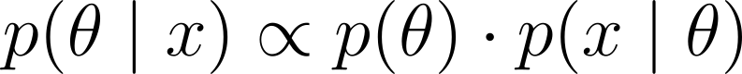
POSTERIOR
PRIOR
LIKELIHOOD

Slide 14
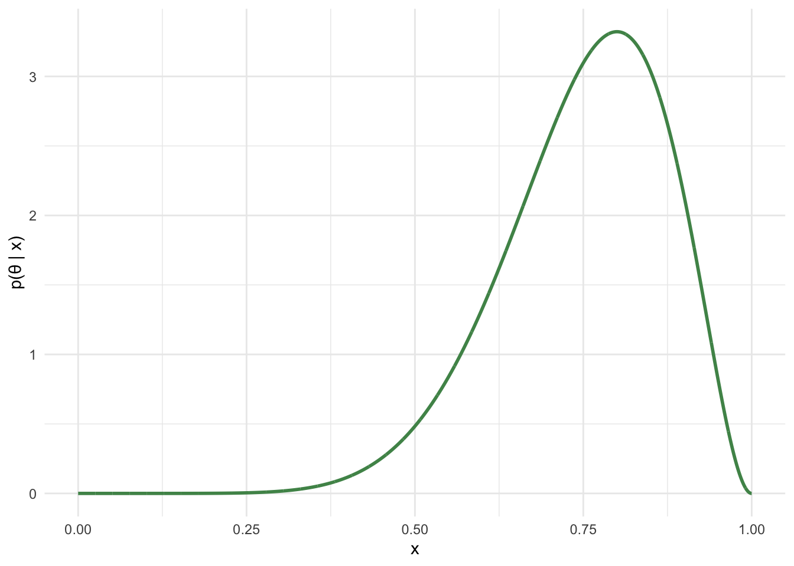
POSTERIOR
PRIOR
LIKELIHOOD

Slide 16
LIKELIHOOD
UNKNOWN CONSTANT

Slide 17
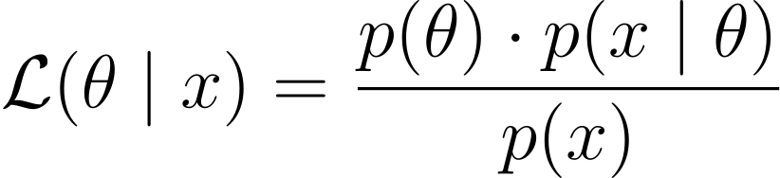
LIKELIHOOD
UNKNOWN CONSTANT

Slide 18
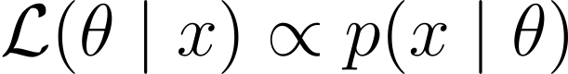
LIKELIHOOD

Slide 19
LIKELIHOOD FUNCTION
LIKELIHOOD

Slide 20
LIKELIHOOD FUNCTION
LIKELIHOOD

Slide 21
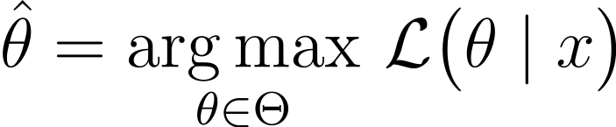
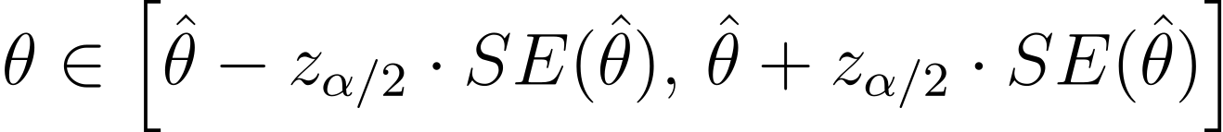
LIKELIHOOD FUNCTION
LIKELIHOOD
Notes:
\hat{\theta}
= \operatorname*{arg\,max}_{\theta \in \Theta}
\,\mathcal{L}\bigl(\theta \mid x\bigr)

Slide 22
Quantities of interest
Descriptive inferences
Predictive inferences
Counterfactual inferences
Descriptive statistics
Statistical inferences
Causal inferences
Data summaries
data + statistical model
(associations/statistical relationships)
data + favstats
data + statistical model + causal model
(causal effects/causal relationships)

Slide 23
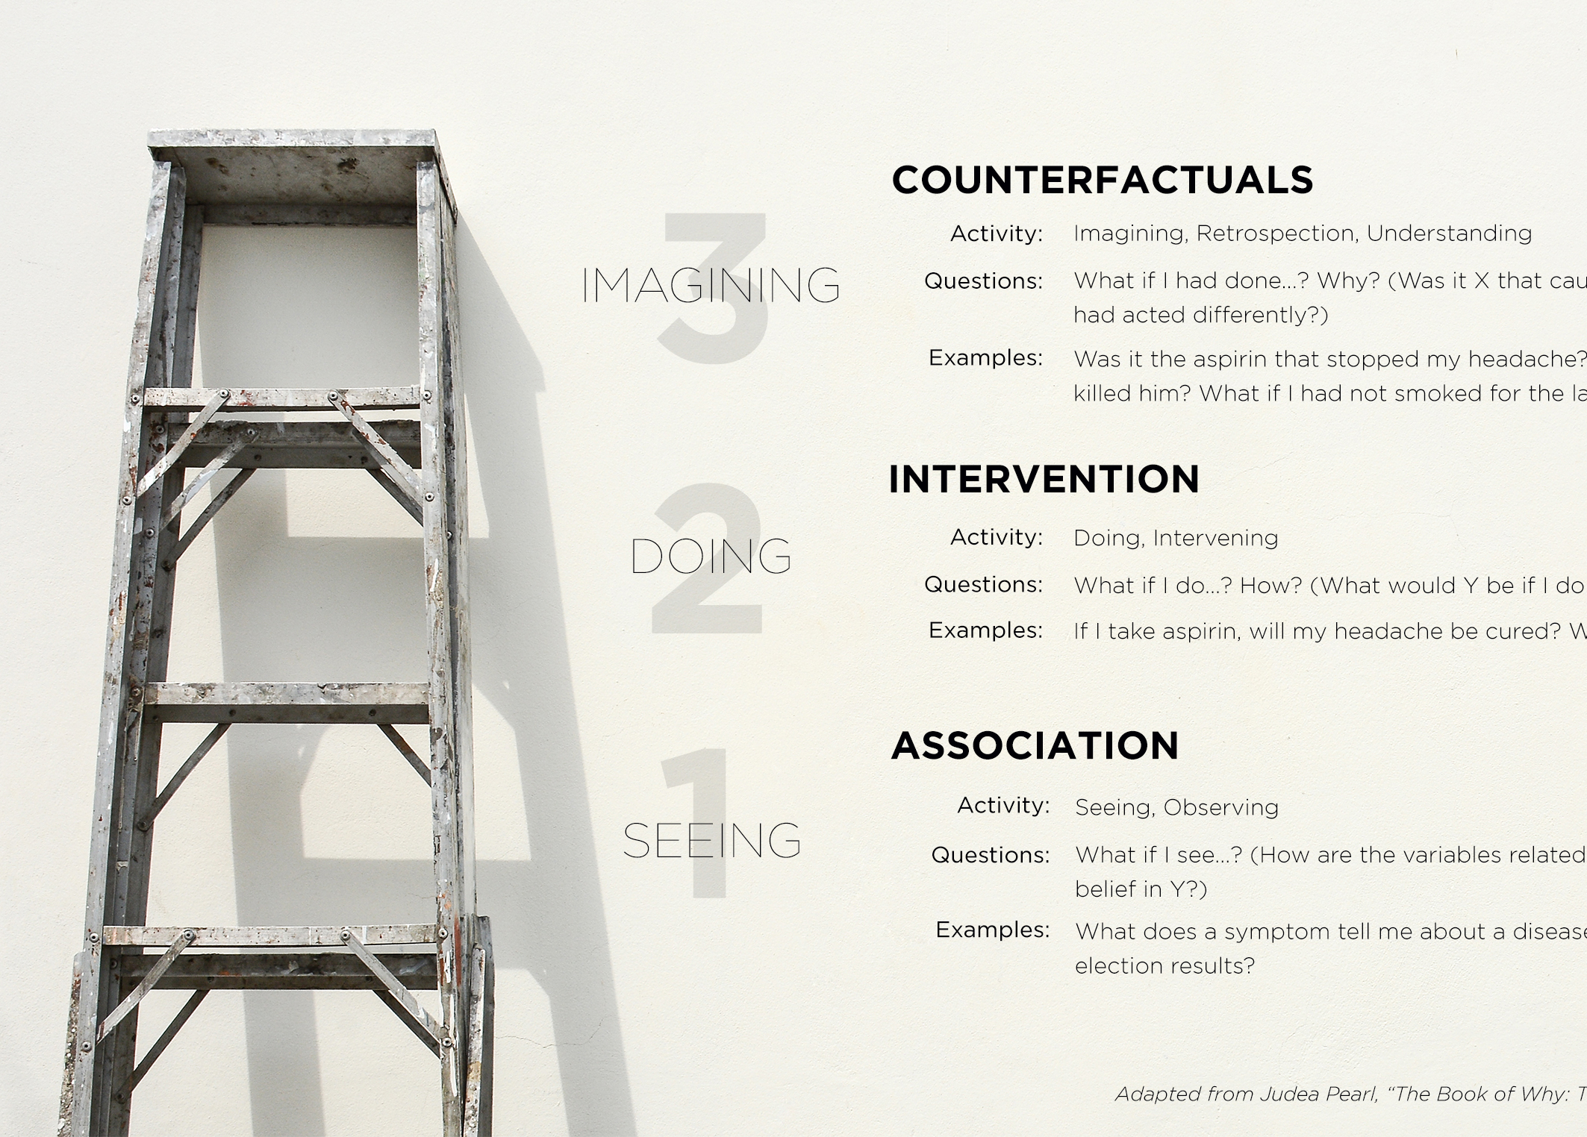

Slide 24
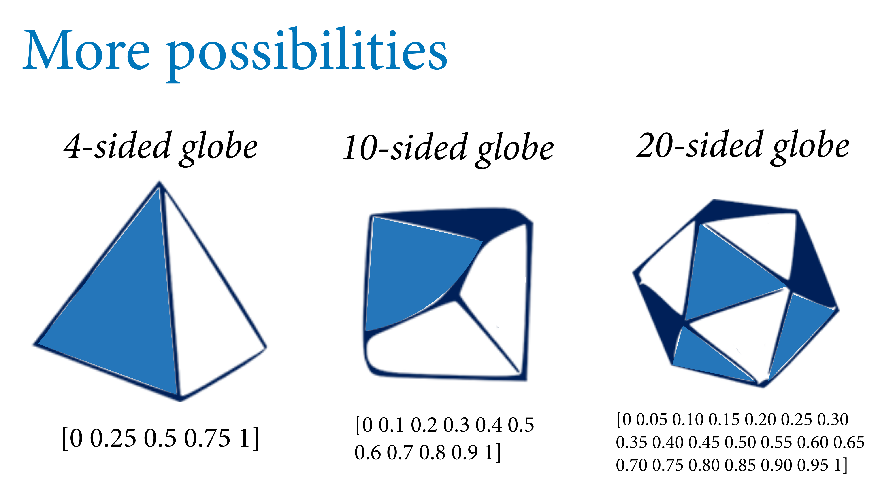
π = proportion of surface covered with water

Slide 25
π = proportion of surface covered with water

Slide 26
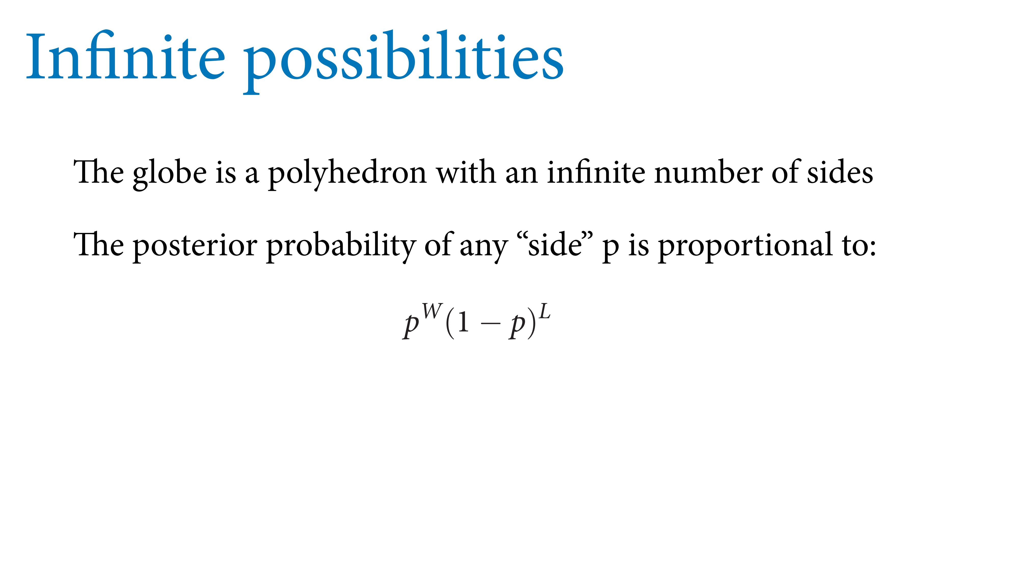

π = proportion of surface covered with water

Slide 27
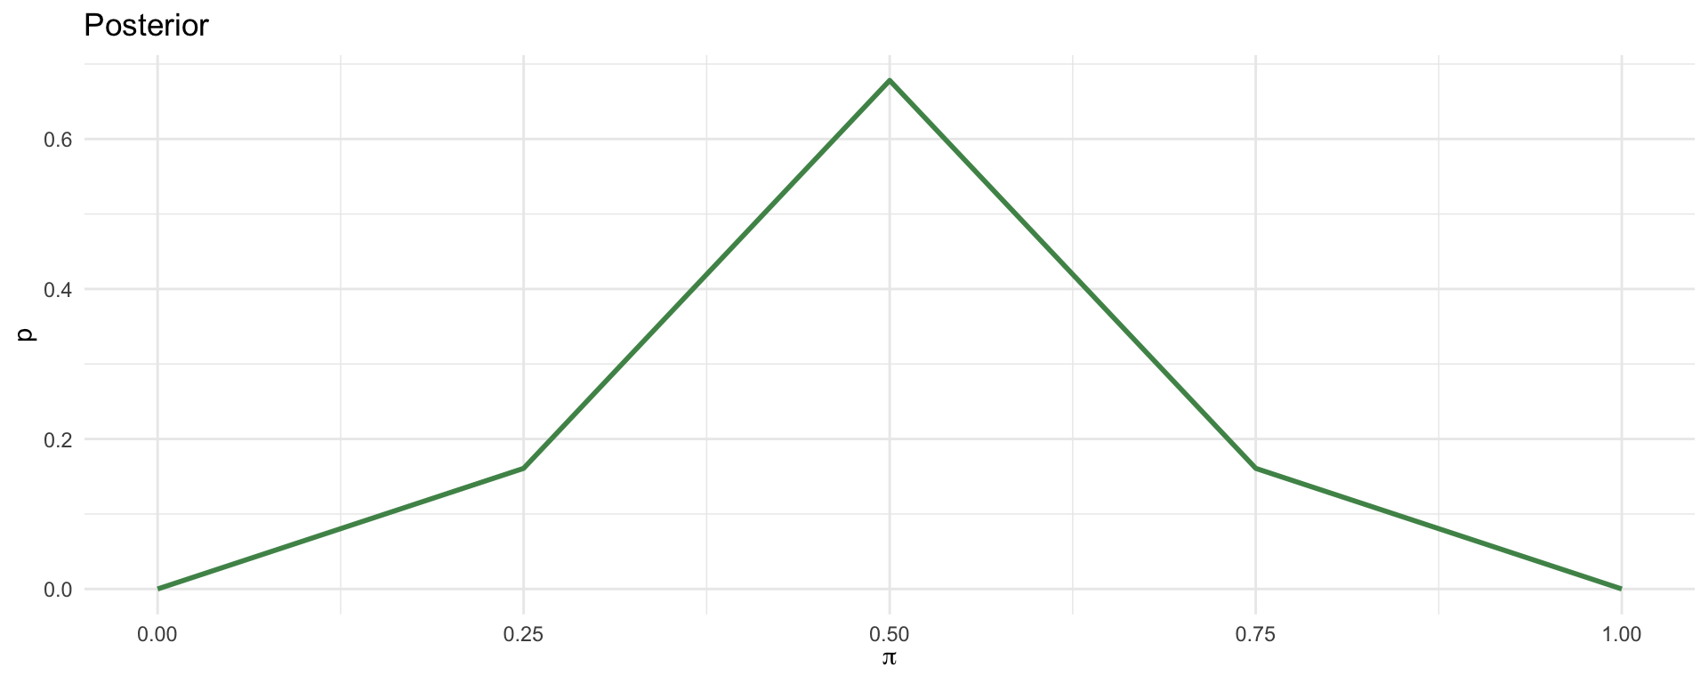
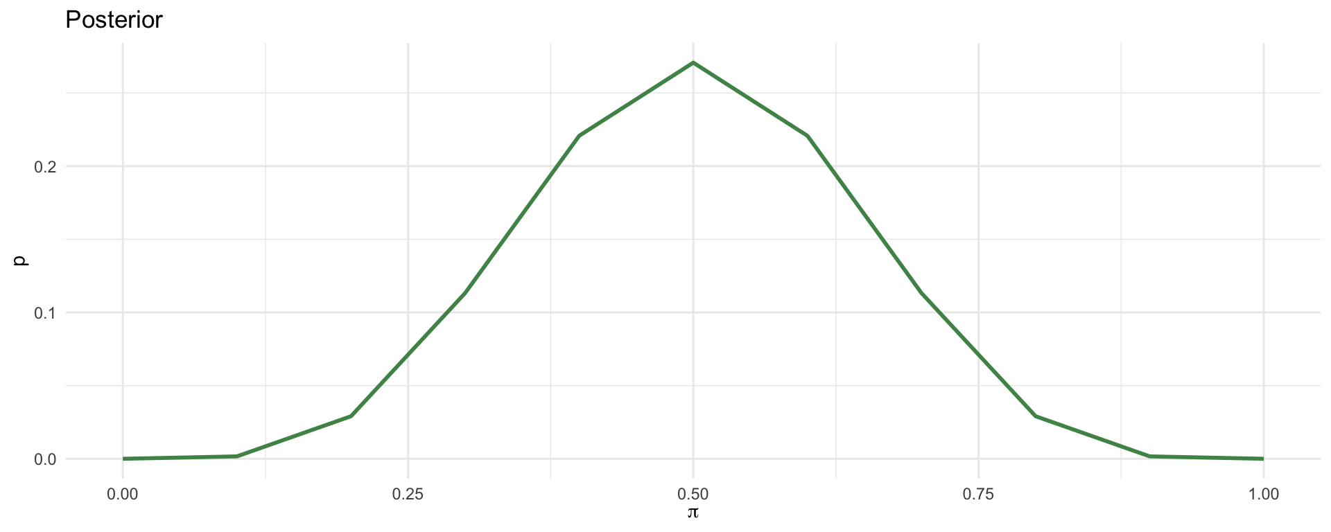
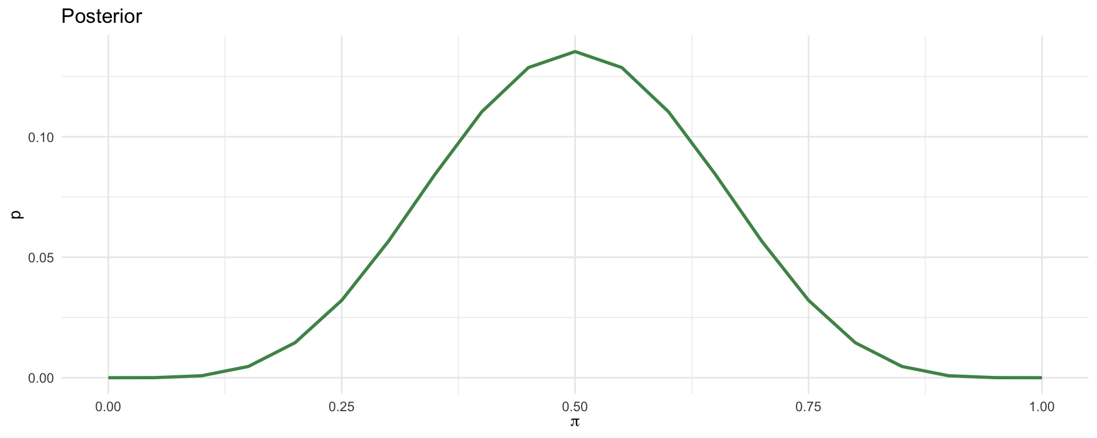
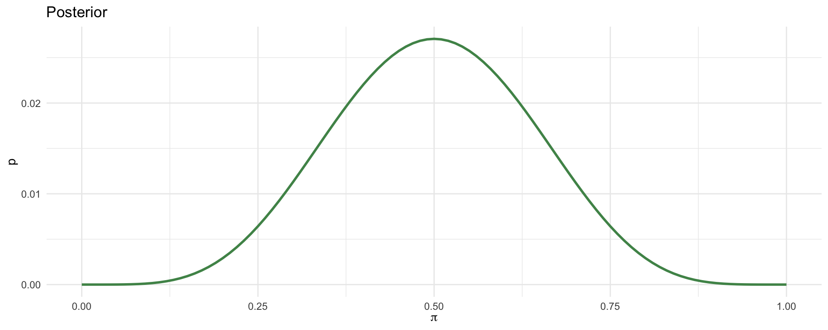

Slide 28
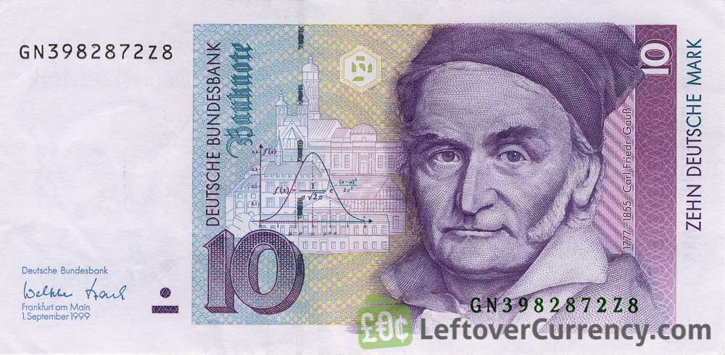
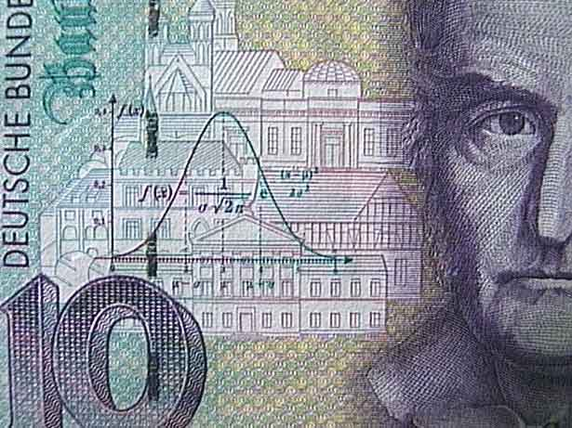

Slide 29
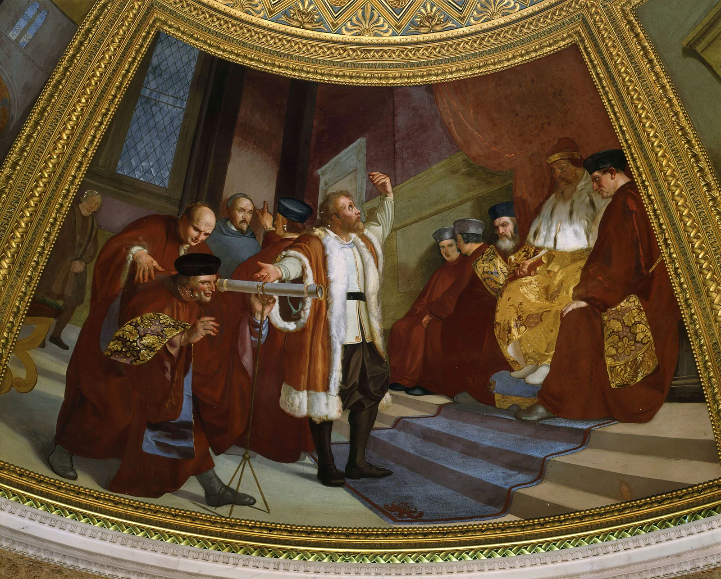
Replication/Revision/Rejection
Conclusion
L(M|D) ∝ P(D|M) Frequentist
P(M|D) ∝ P(D|M) · P(M) Bayesian
Causal claim
Causal effects Explanations
Causal inference
Galileo Galilei (1564-1642) the “father of modern science”
Data
Model
Inference algorithm
Statistical inference Machine learning
Observations
Predictions
P(D|M)
Natural process
Causal model
DGP model
Probability theory
Inductive reasoning
Real world
Abstract world
Propositional logic Deductive reasoning
Empiricism
Rationalism
Notes:
A probability model is the triplet (Ω, σ-algebra, P)
Generative vs Discriminative

Slide 30
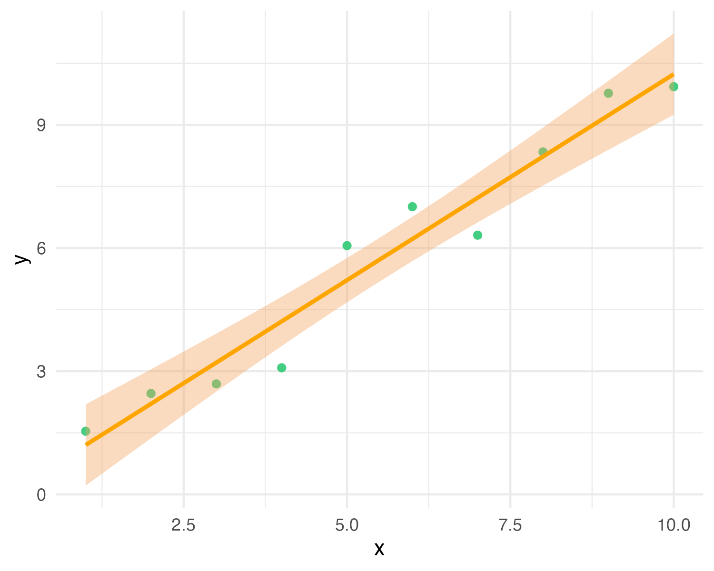
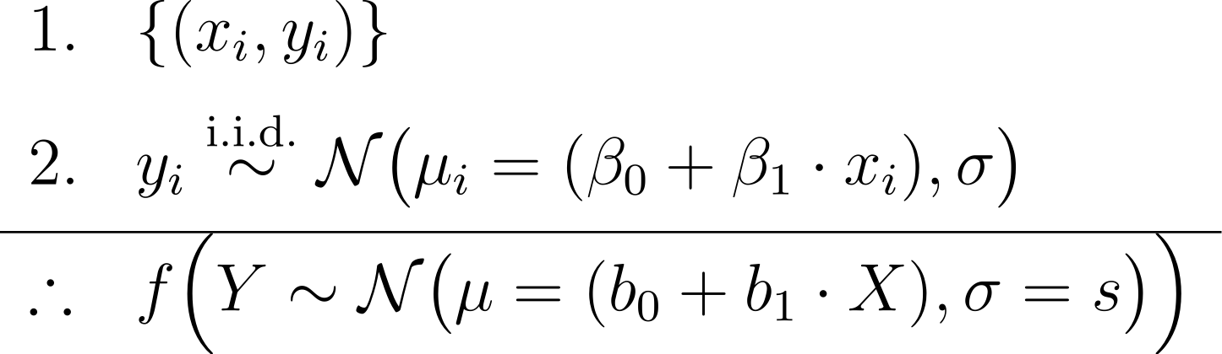
y_{i} ∼ N(μ_{i} = (β₀ + β₁ · x_{i}), σ)
premises assumptions evidence KB
premises
data
causal model
conclusion
likelihood (+ prior)
estimator
Y = b₀ + b₁X with CI
MLE (or posterior) predictive model
effect
= conclusion claim hypothesis query
Notes:
In Bayesian inference we add priors to the premises, and obtain a joint posterior distribution of the parameters conditioned on the data p(beta0, beta1, sigma | data), or a posterior predictive distribution as conclusion
In frequentist inference we obtain maximum-likelihood estimates of the parameters (b0, b1, s)
https://latex.unacademy.com/
\begin{array}{ll}
1. & \{(x_i, y_i)\} \\[6pt]
2. & y_i \stackrel{\text{i.i.d.}}{\sim} \mathcal{N}\bigl(\mu_i = (\beta_0 + \beta_1 \cdot x_i), \sigma\bigr) \\[4pt]
\hline
\therefore & f \Bigl(Y \sim \mathcal{N}\bigl(\mu = (b_0 + b_1 \cdot X), \sigma = s\bigr)\Bigr) \\
\end{array}

Slide 31
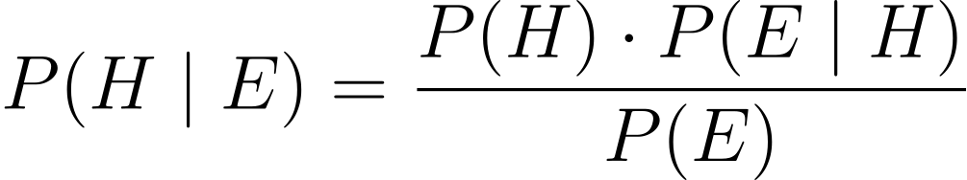
PRIOR
LIKELIHOOD
POSTERIOR
EVIDENCE

Slide 32
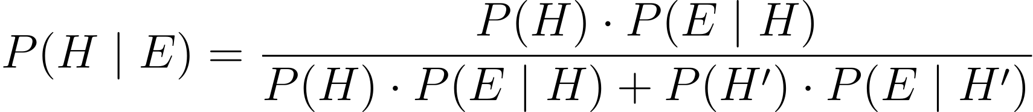
PRIOR
LIKELIHOOD
POSTERIOR
EVIDENCE

Slide 33
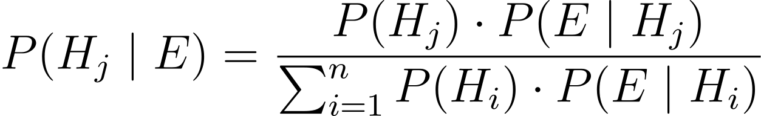
PRIOR
LIKELIHOOD
POSTERIOR
EVIDENCE

Slide 34
POSTERIOR
PRIOR
LIKELIHOOD

Slide 35
PRIOR
LIKELIHOOD
POSTERIOR
EVIDENCE

Slide 36
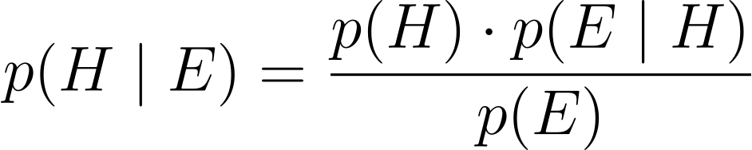
PRIOR
LIKELIHOOD
POSTERIOR
EVIDENCE

Slide 37
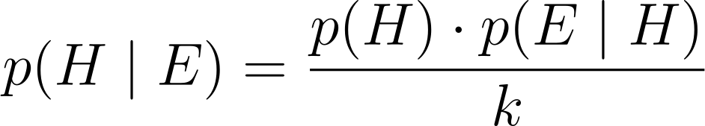
PRIOR
LIKELIHOOD
POSTERIOR
KNOWN NORMALIZING CONSTANT

Slide 38
POSTERIOR
PRIOR
LIKELIHOOD

Slide 39
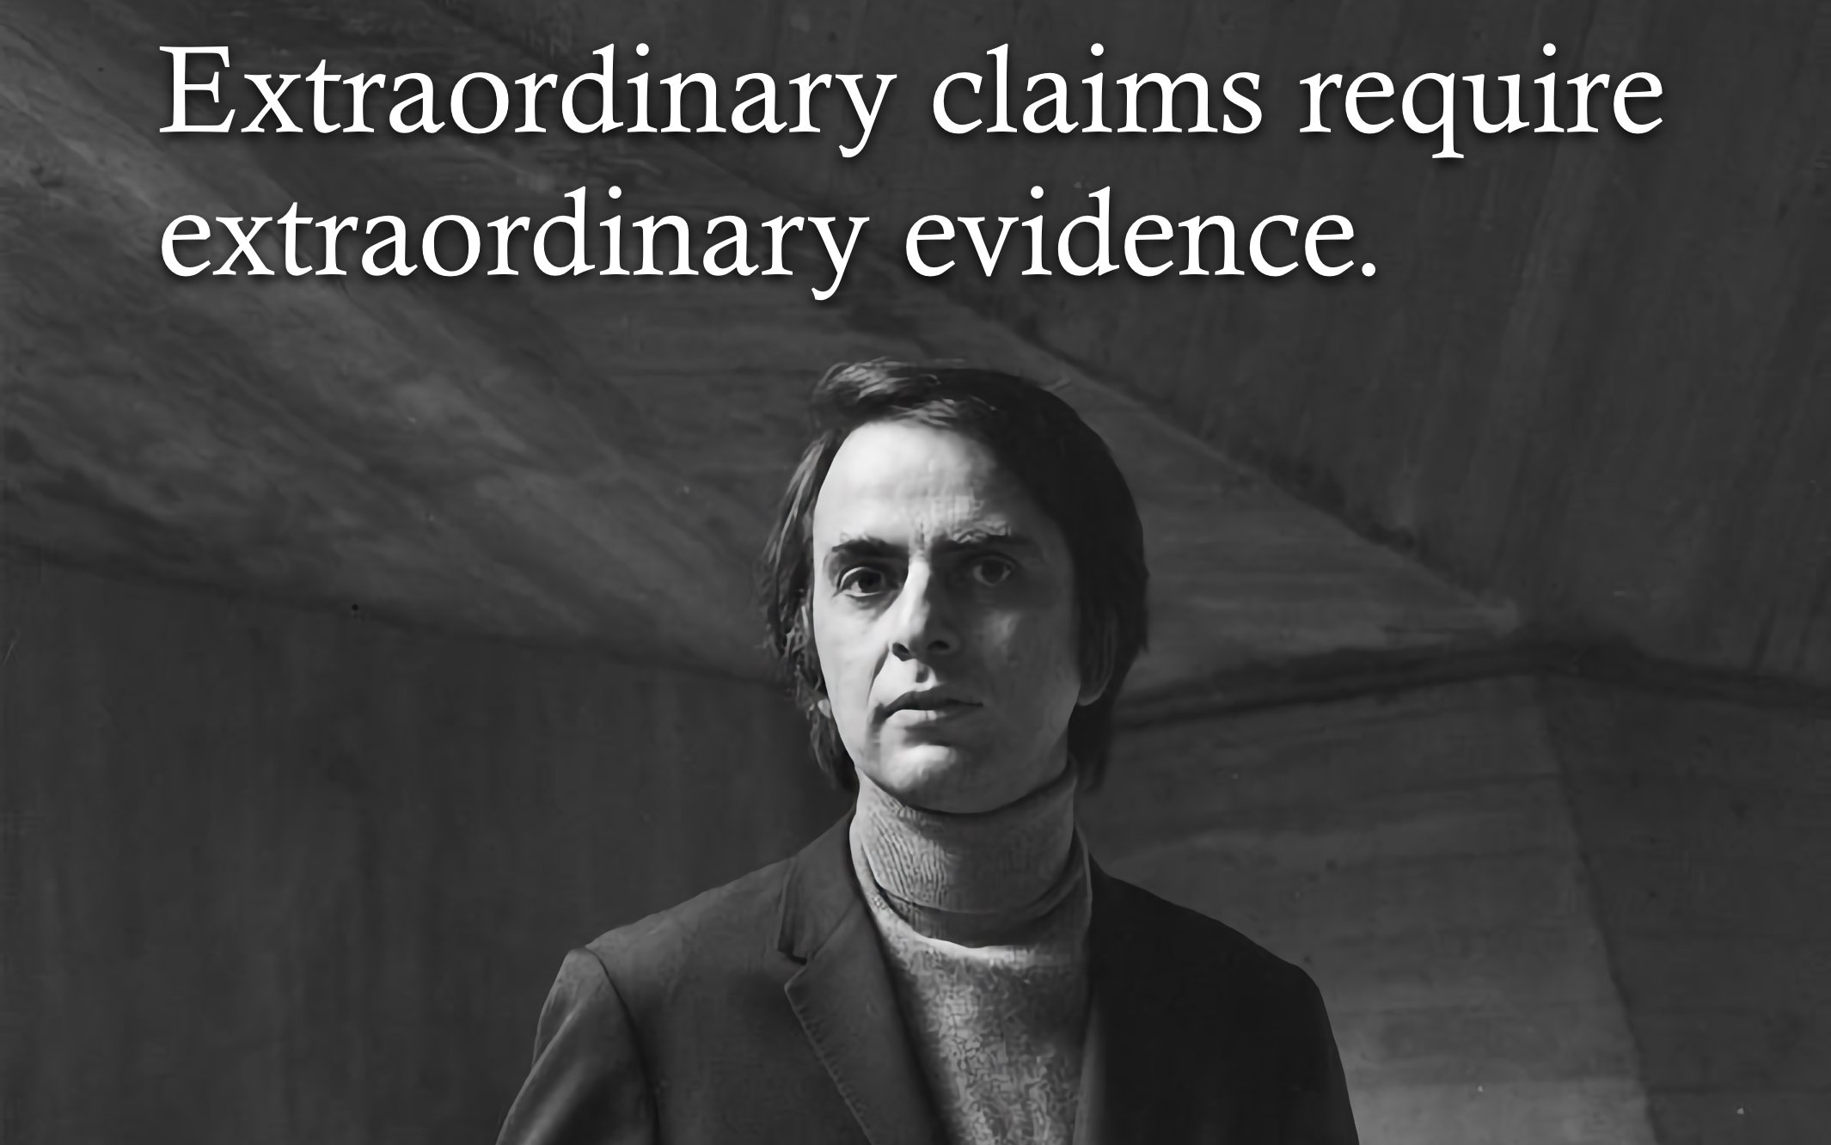
POSTERIOR
PRIOR
LIKELIHOOD

Slide 40
PRIOR
LIKELIHOOD
POSTERIOR
EVIDENCE

Slide 41
LIKELIHOOD
EVIDENCE

Slide 42
LIKELIHOOD
UNKNOWN CONSTANT

Slide 43
LIKELIHOOD
UNKNOWN CONSTANT

Slide 44
LIKELIHOOD FUNCTION
LIKELIHOOD
UNKNOWN CONSTANT

Slide 45
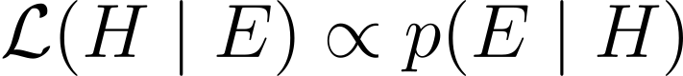
LIKELIHOOD FUNCTION
LIKELIHOOD

Slide 46

Notes:
A probability model is the triplet (Ω, σ-algebra, P)
Generative vs Discriminative

Slide 47
Replication/Revision/Rejection
Conclusion
L(M|D) ∝ P(D|M) Frequentist
P(M|D) ∝ P(D|M) · P(M) Bayesian
Causal claim
Causal effects Explanations
Causal inference
Data
Model
Inference algorithm
Statistical inference Machine learning
Observations
Predictions
P(D|M)
Natural process
Causal model
DGP model
Probability theory
Inductive reasoning
Real world
Abstract world
Propositional logic Deductive reasoning
Empiricism
Rationalism
Notes:
A probability model is the triplet (Ω, σ-algebra, P)
Generative vs Discriminative

